Slide 1
The Cup Holder Stem Challenge
From PECG San Diego Section
Notes:
Hi Everyone, The professional engineers in California government have a challenge for you today. This is a challenge you can do at home with common items found at home, or easily bought at your local store.

Slide 2
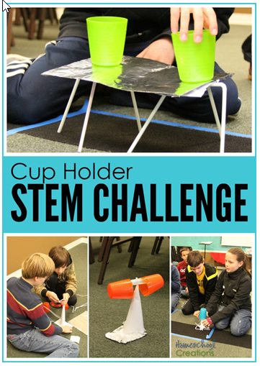
Here is the Challenge:
Create a structure that holds two cups as high as possible and as far apart as possible. Each person has 2 minutes to design, 7 minutes to create, and 1 minute to test their structure. It must be able to stand on its own.
Notes:
Read Challenge

Slide 3
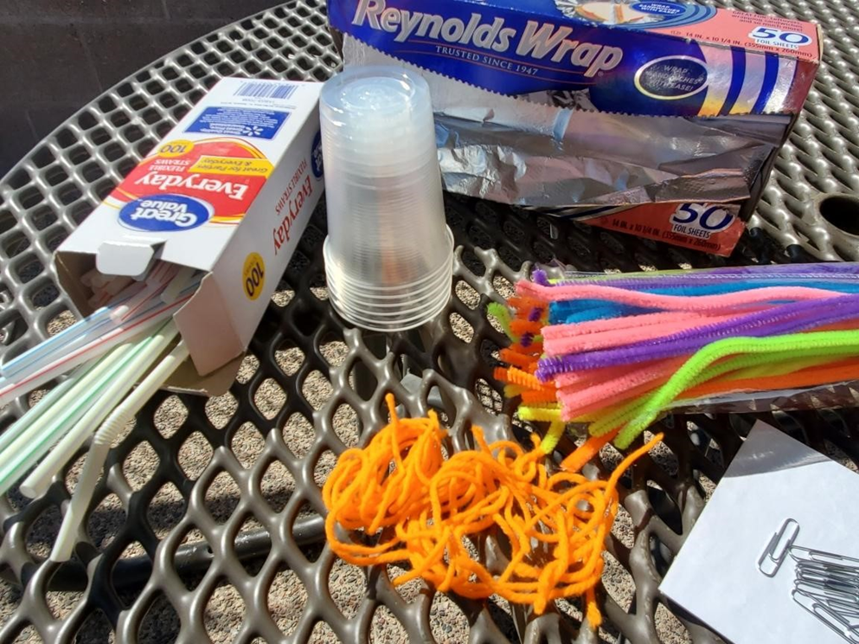
Materials Allowed:
6 straws
1 piece paper
1 piece of tinfoil
3 mailing labels
2 paperclips
2 pieces of string
1 envelope
2 pipe cleaners
5 pennies
Notes:
Read the above Item list and then add the following;
You may use any of the materials you need from the list, but you don’t have to use all of them. You may wonder “Why would you need the pennies”? They can be used as a weight to help balance or steady the cup holder to keep from tipping.

Slide 4
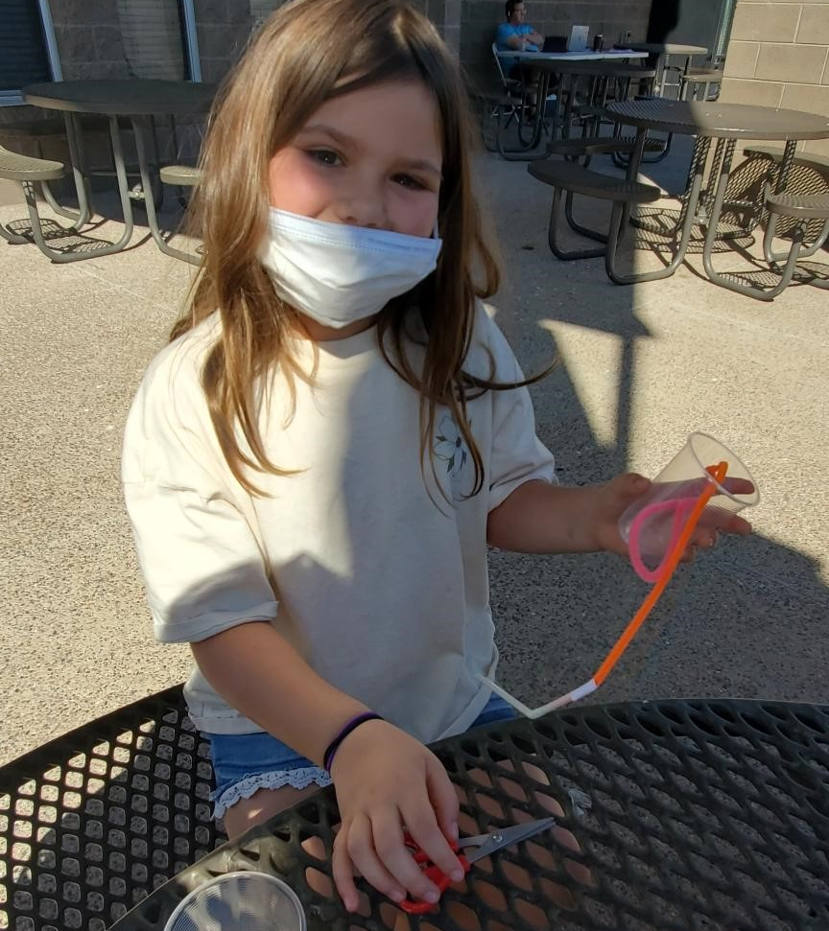
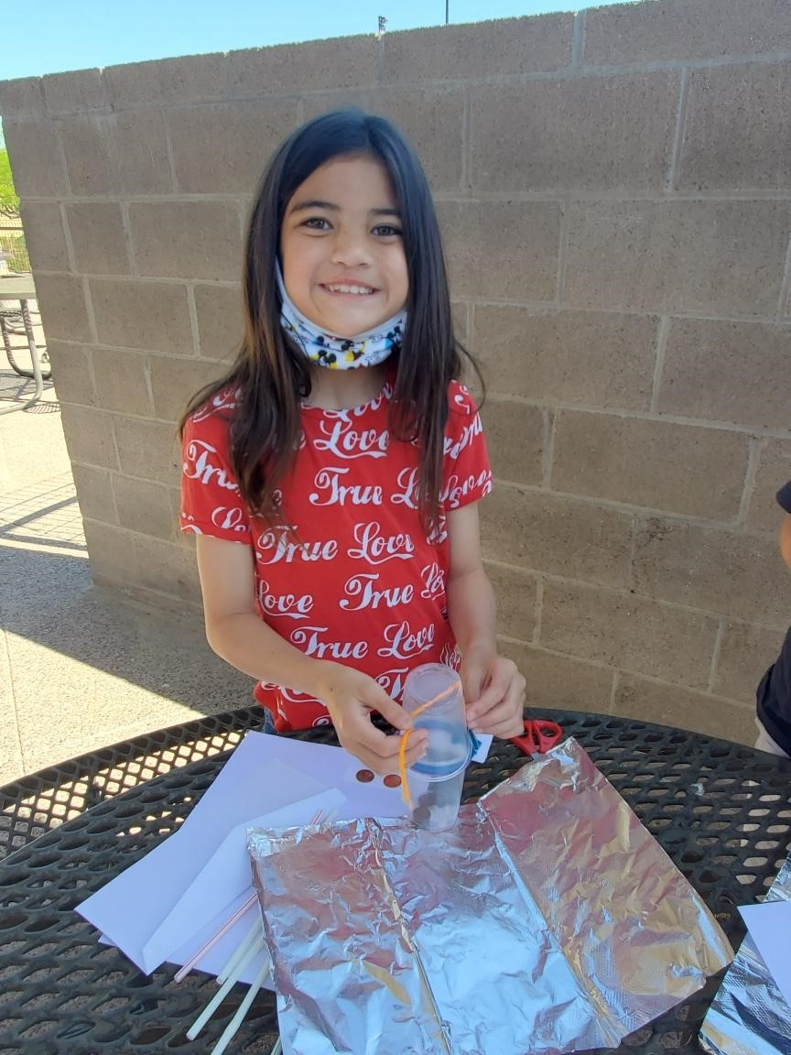
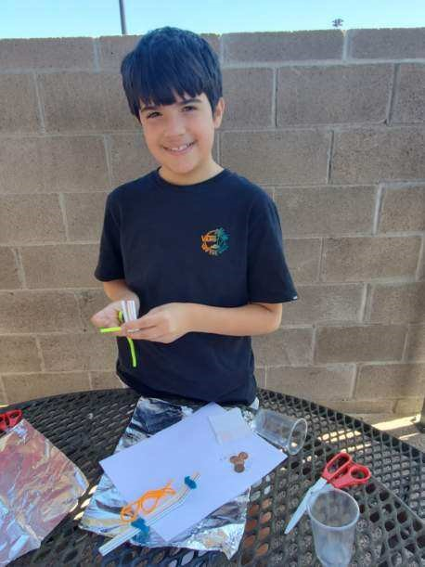
We found some volunteers to help us out with this challenge.
Notes:
Here are a few of our volunteers that will help us work through this challenge.

Slide 5
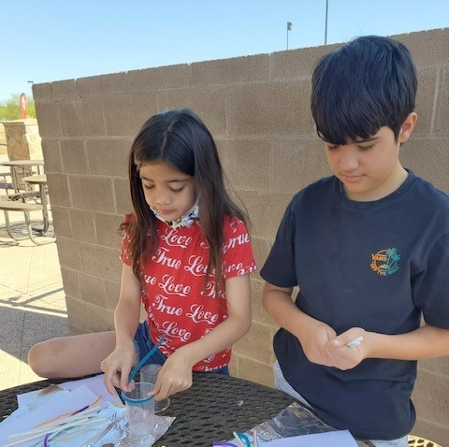
It is beneficial to use your 2 minutes to think it about your strategy before starting, because paper or tin foil will weaken as you fold or crush them.
Notes:
Don’t forget to take time to think about your project first before bending or rolling your materials since they may not be as strong once worked with, especially the foil and paper.

Slide 6
One of the things that I love about this challenge is seeing the creativity each student produces in their design. Even though they each have the same materials, they find different ways to use the items together.
_________________________________
Notes:
Read text

Slide 7
Students from 5 to 13 years old love to do this challenge.
You can also do it in groups as a competition.
By sharing the challenge outcomes, you will learn from the other students’ successes and mistakes.
Notes:
Read Text

Slide 8
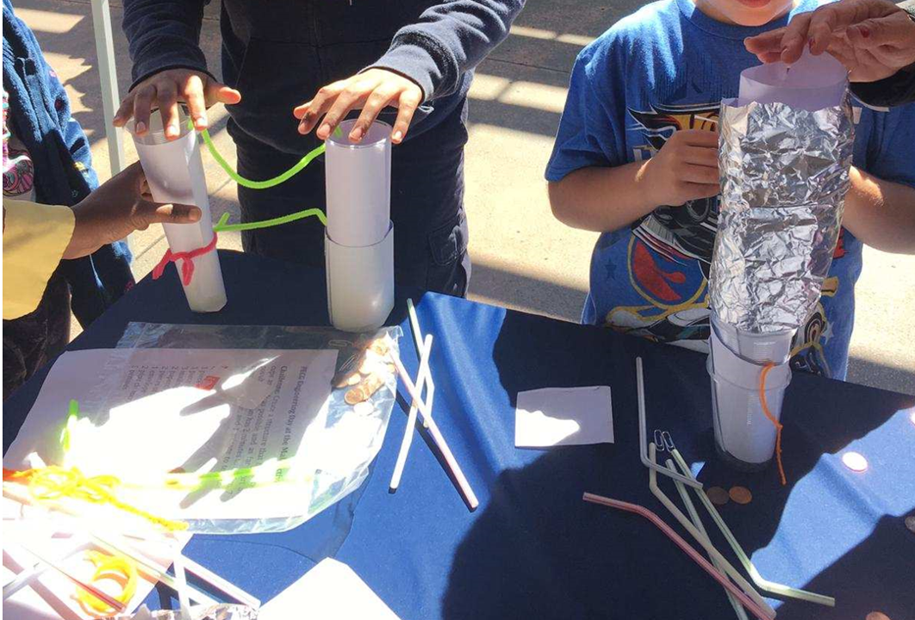
Remember you get points for every inch your cups are off the ground and a point for each inch they are apart from each other.
This one on the left had great height but it couldn’t stand on its own.
Notes:
Read text

Slide 9
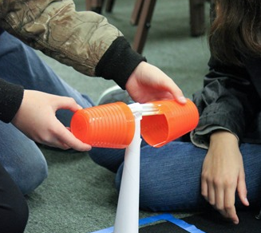
Very creative way to get the cups up high but this one had trouble standing up on its own for more than a few seconds although it had great height.
Notes:
This challenger was very creative and got great height with the cup holder, but the structure couldn’t hold it up for more than a few seconds.

Slide 10
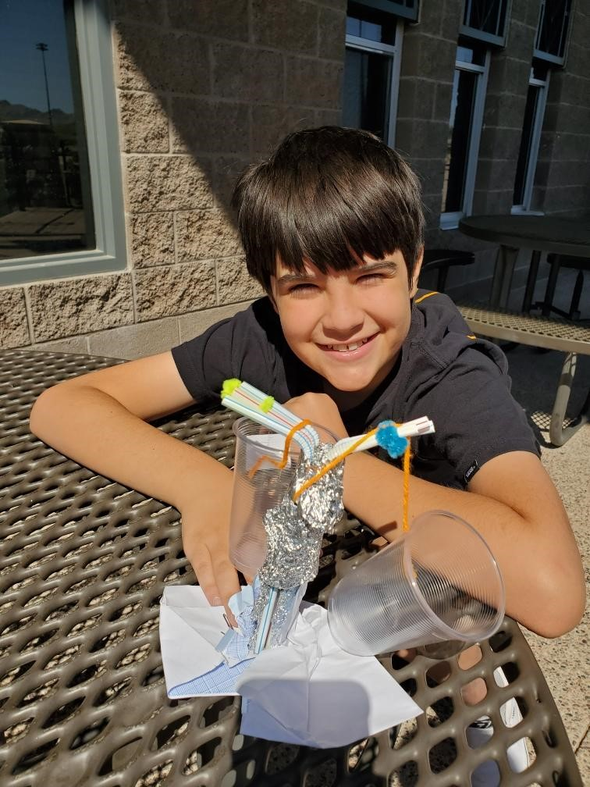
Here is another partial success with both cups off the ground and apart, but the stability to stand on its own wasn’t met for more than a few seconds.
When working outside the wind can be an additional challenge.
Notes:
Read text

Slide 11
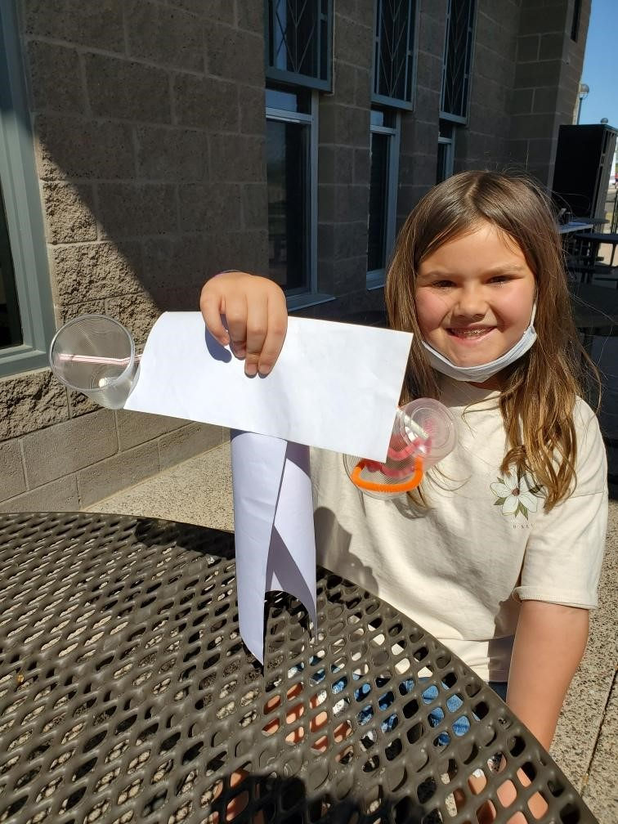
Another challenge that doesn’t stand on its own even though the other criteria were met.
Notes:
Remember the most important part of the challenge is for the cup holder to support itself and be able to stand up on its own.

Slide 12
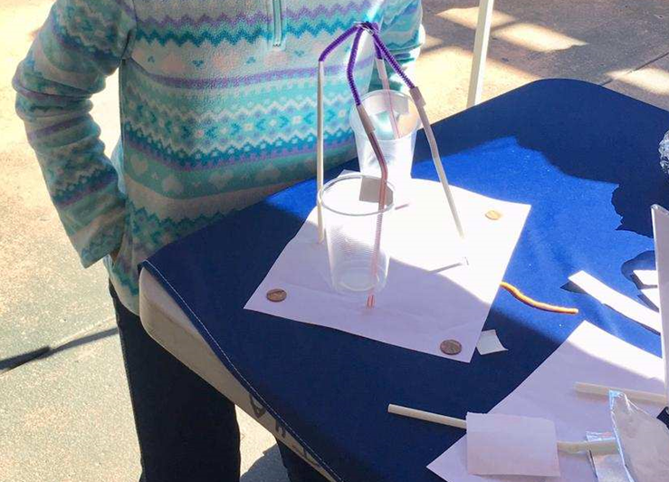
Success on being off the ground and stable on its own, although the cups are still touching, she still gets points for the height.
Notes:
Here we have a successful cup holder with stability and height. No extra points for distance apart though.

Slide 13
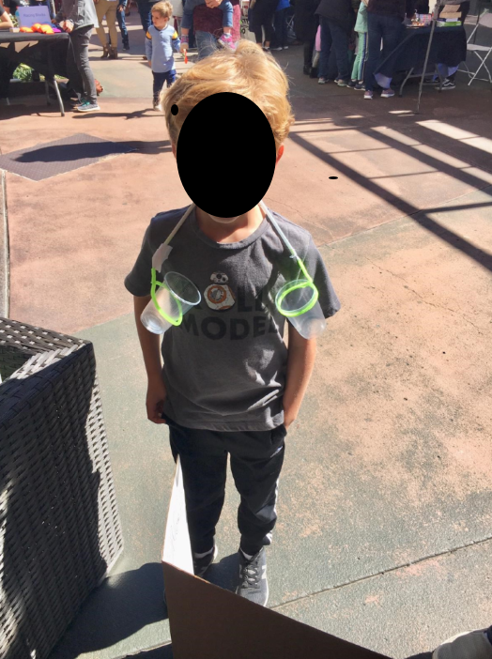
This young man was definitely thinking outside the box!
Notes:
I loved his choice, he said nobody told me it had to sit on the table. ☺

Slide 14
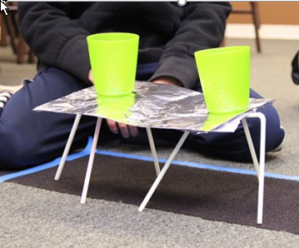
Try to beat this successful entry with the Cup Holder Challenge!
Notes:
From the challengers I have seen, this cup holder has scored the most points yet. But I know that you can do even better!

Slide 15
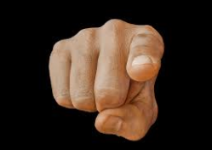
We want you to join us and do the cup holder challenge!
Diane.Vermeulen@dot.ca.gov
Notes:
Please join us to do the cup holder challenge at home
Please use only the items we have listed ,
Once you have completed the challenge. Please Document your cup holder with a photo and send us the height off the ground and the width apart and we will send the winner a $100 award !

